Slide 1
Jazykova skola Palisady, Bratislava
Job shadowing learning blog
ERASMUS+ Participant Report Form – KA1 –
Learning Mobility of Individuals

Slide 2
Table of contents
Our week of job shadowing at Jazykova Skola Palisady
01
03
04
The city
02
The school
The job shadowing
The takeaways

Slide 3
01
The city

Slide 4
Where is Bratislava?
Bratislava is the capital and largest city of the Slovak Republic and the fourth largest of all cities on the river Danube. Officially, the population of the city is about 475,000; however, some sources estimate daily number of people moving around the city based on mobile phone SIM cards is more than 570,000. Bratislava is in southwestern Slovakia at the foot of the Little Carpathians, occupying both banks of the Danube and the left bank of the River Morava. Bordering Austria and Hungary, it is the only national capital to border two sovereign states.

Slide 5
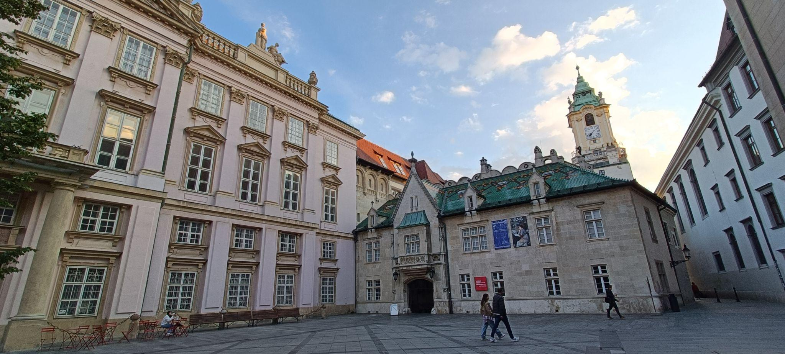
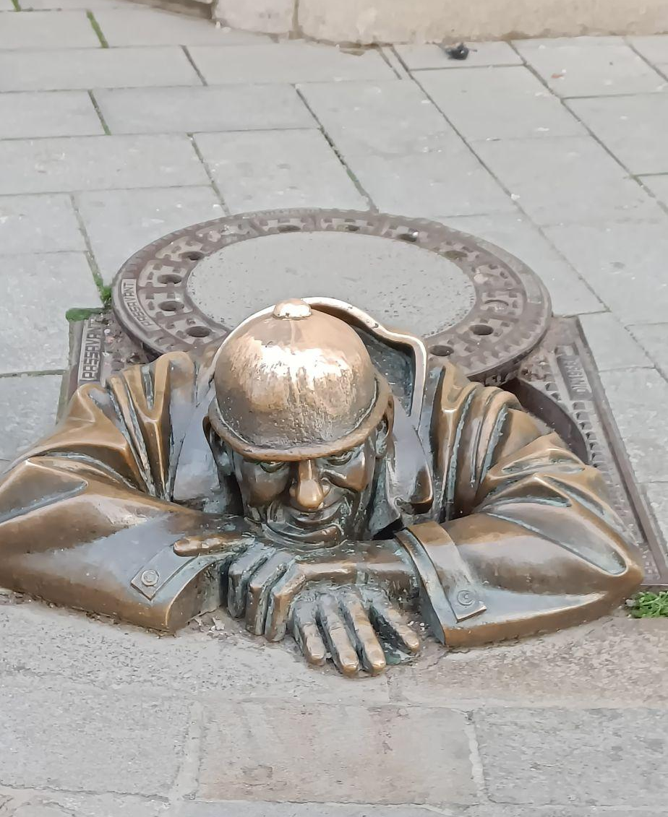
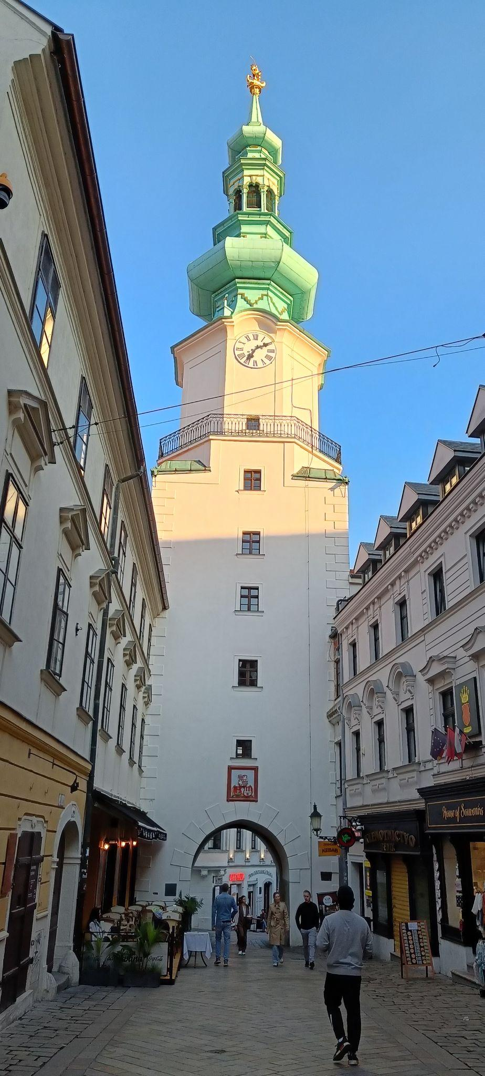
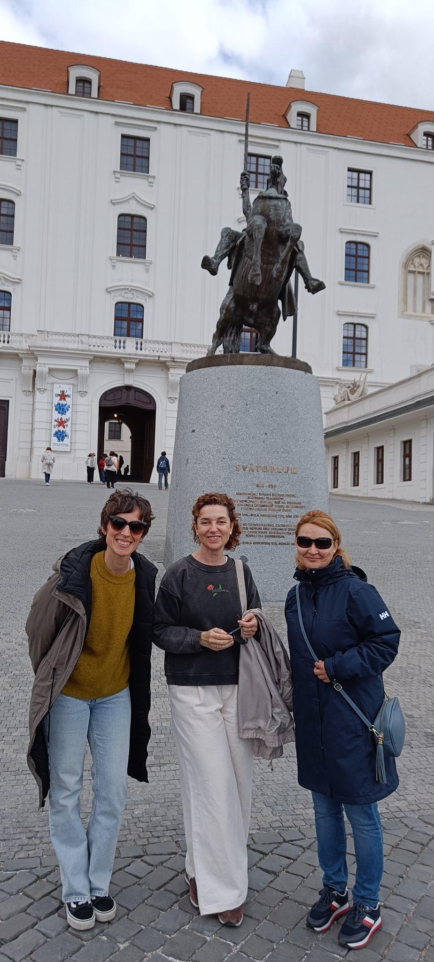
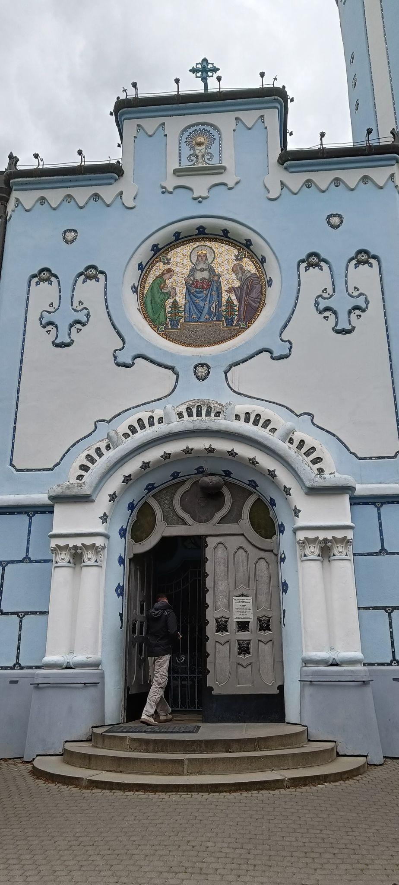
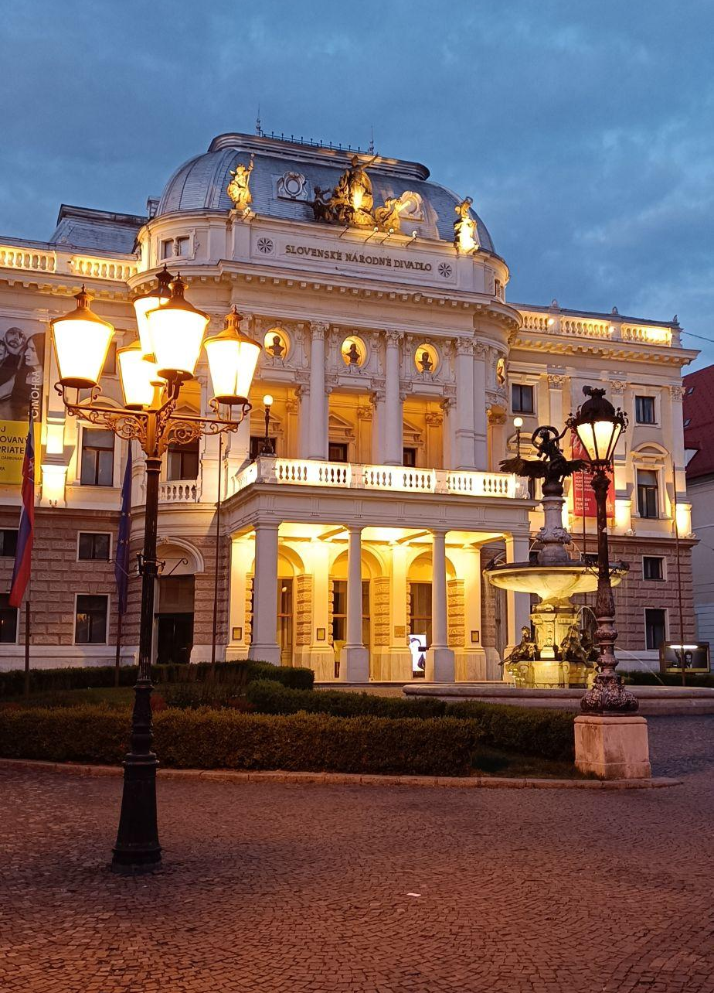
Bratislava

Slide 6
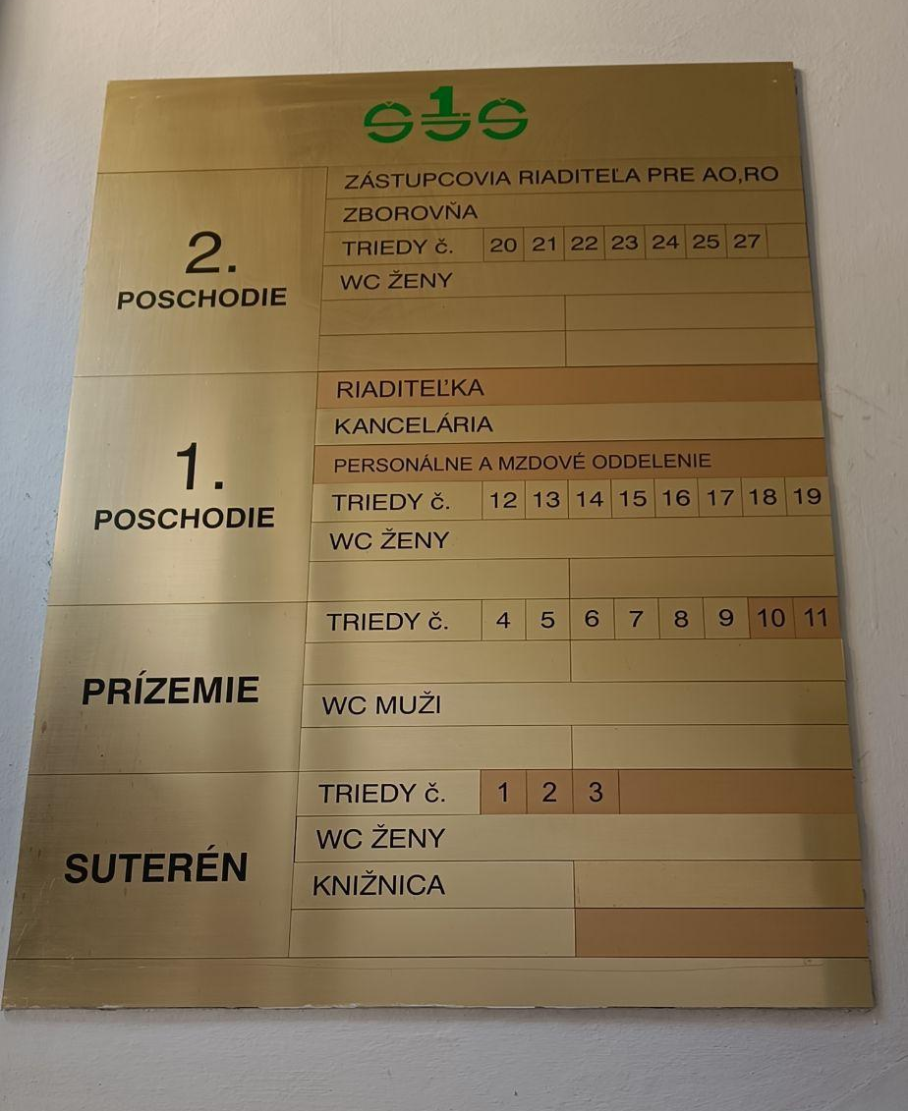
02
The school
70 years of language teaching history

Slide 7
About the school
The state language exam certificate issued by the school is accepted at universities in both the Slovak and Czech Republics. It serves as proof of knowledge of a foreign language at the proclaimed level of the Common European Framework of Reference for Languages ​​in state and public administration - as well as in the private sector. Taking into account the type of state language exam /basic, general, professional, special/ and the valid school legislation, it allows students to practice the teaching profession in the teaching of a given foreign language and is a relevant document when obtaining a trade license for services in the field of foreign languages.
Jazykova skola (see link) has been teaching languages since the 1950s. It is a public school of languages for adult education, which can certify the CEFR levels with official exams.
The language offer may vary slightly from year to year, as it is adapted to the specific interests of the students. They offer a total of 14 languages: English, German, French, Spanish, Italian, Arabic, Russian, Slovak, Japanese, Hebrew, Chinese, Swedish, Korean and Greek.

Slide 8
Course offer
Conversational language courses
Courses for seniors
Preparation for school-leaving exam
Preparatory courses for international certificates
Preparatory courses for state language exams
Refresher courses
Thematically oriented courses: i.e.: legal or economic language

Slide 9
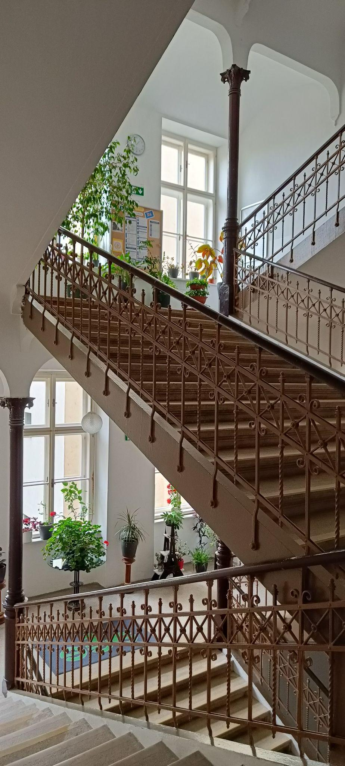
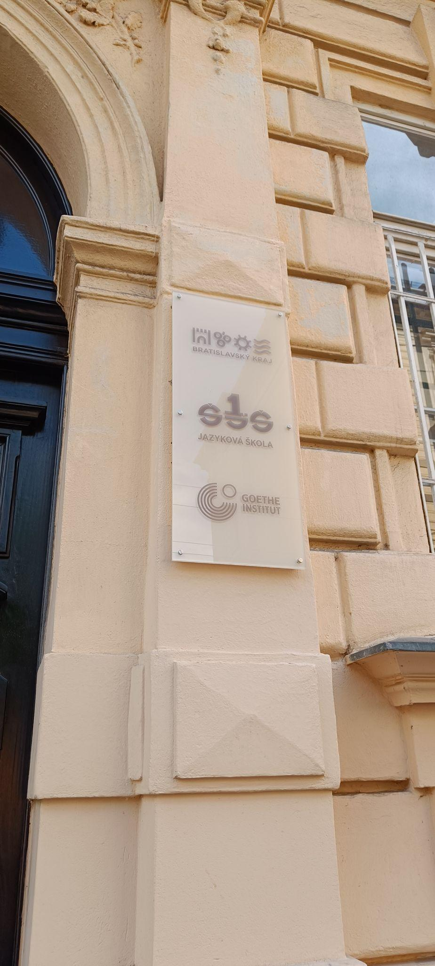
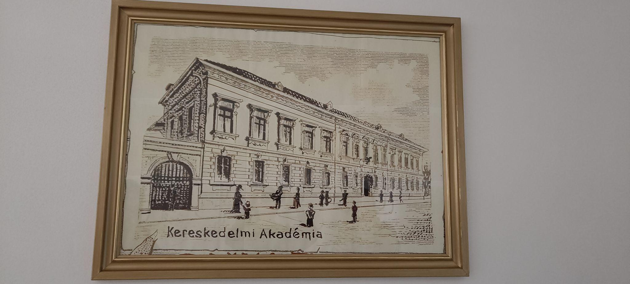
The school

Slide 10
03
The Job shadowing programme

Slide 11
Job shadowing programme
Day 1 | Day 2 | Day 3 | Day 4 | Day 5
Introductory meeting with the head of the English department Welcome tour of the school and introductory talks with the head of the English and Spanish department as well as with the principal. English B2.2 class observation | Talks with the heads of the English and Spanish department regarding certification exams, teachers’ working conditions, course contents, types of courses and timetables. Class observation: Spanish seniors’ class, English B2.2, Conversation class B2.1, English A1, Spanish A1 | Visit to the Slovak National Gallery with the head of the English department Class observation: Spanish B1, English conversation class B2.1 | Lunch with English teacher Joseph Leincz Class observation: English B1, Spanish C1 | Visit to Bratislava Castle and other sights with teacher Viktóira Garulová Class observation: English C1 Closing meeting with head of the English department Farewell dinner

Slide 12
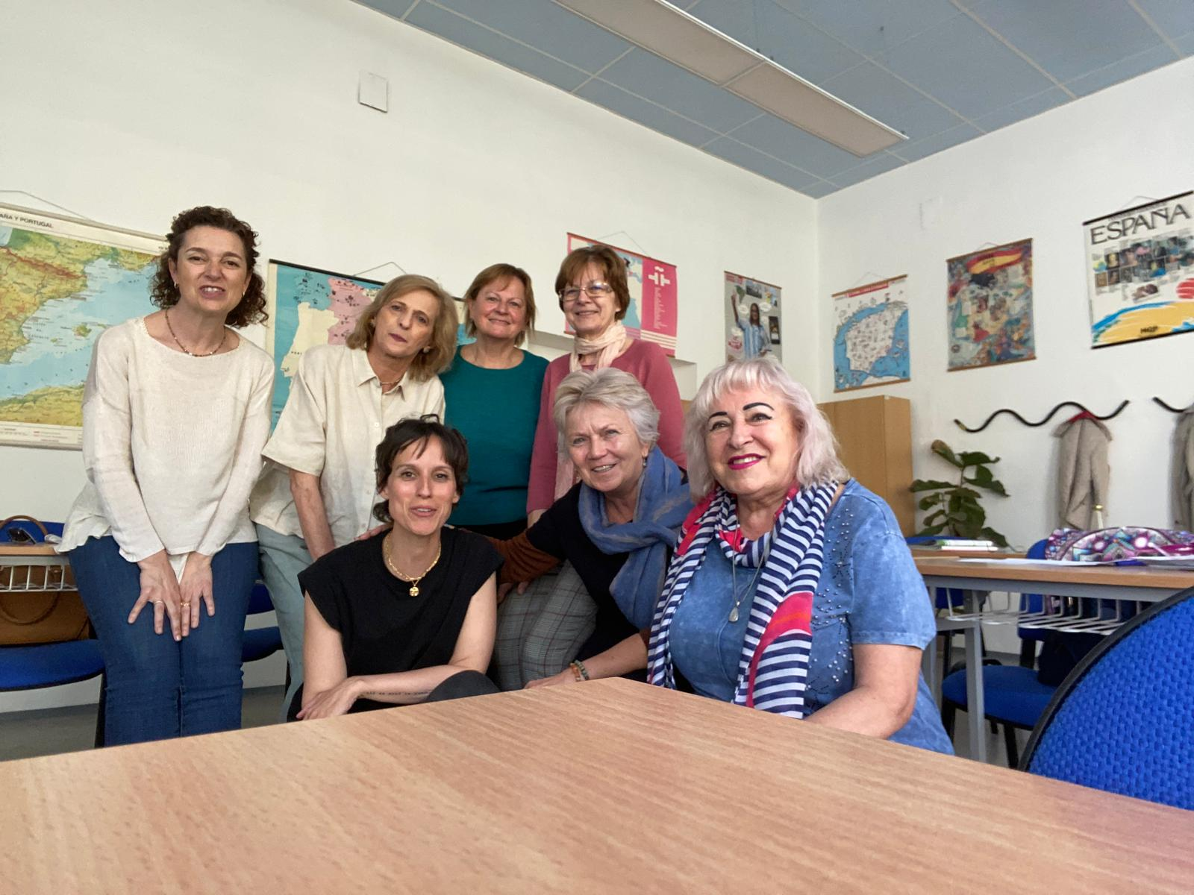
Seniors group
Senior citizens can choose to be either integrated in the general courses or join one of the groups that has been designed exclusively for them. This way, their form of inclusion in long life learning is decided by themselves.

Slide 13
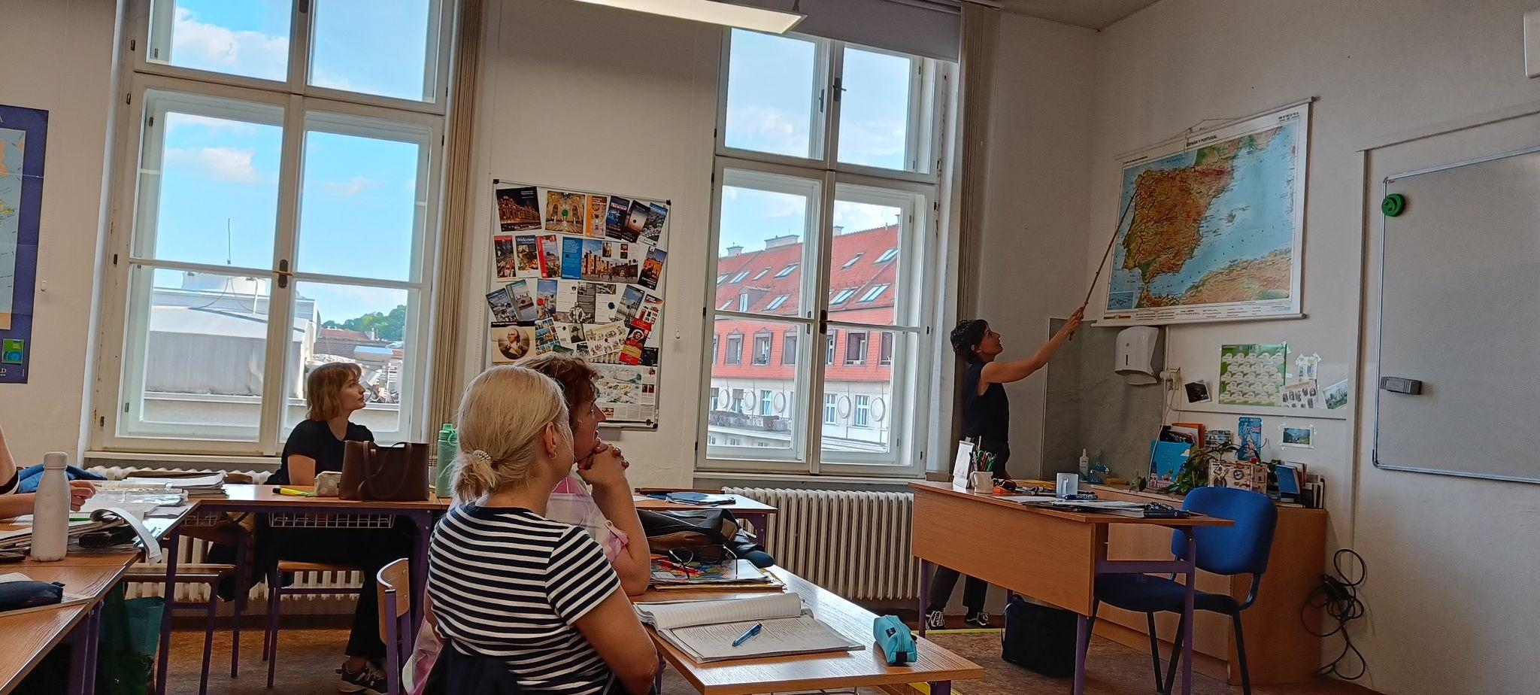
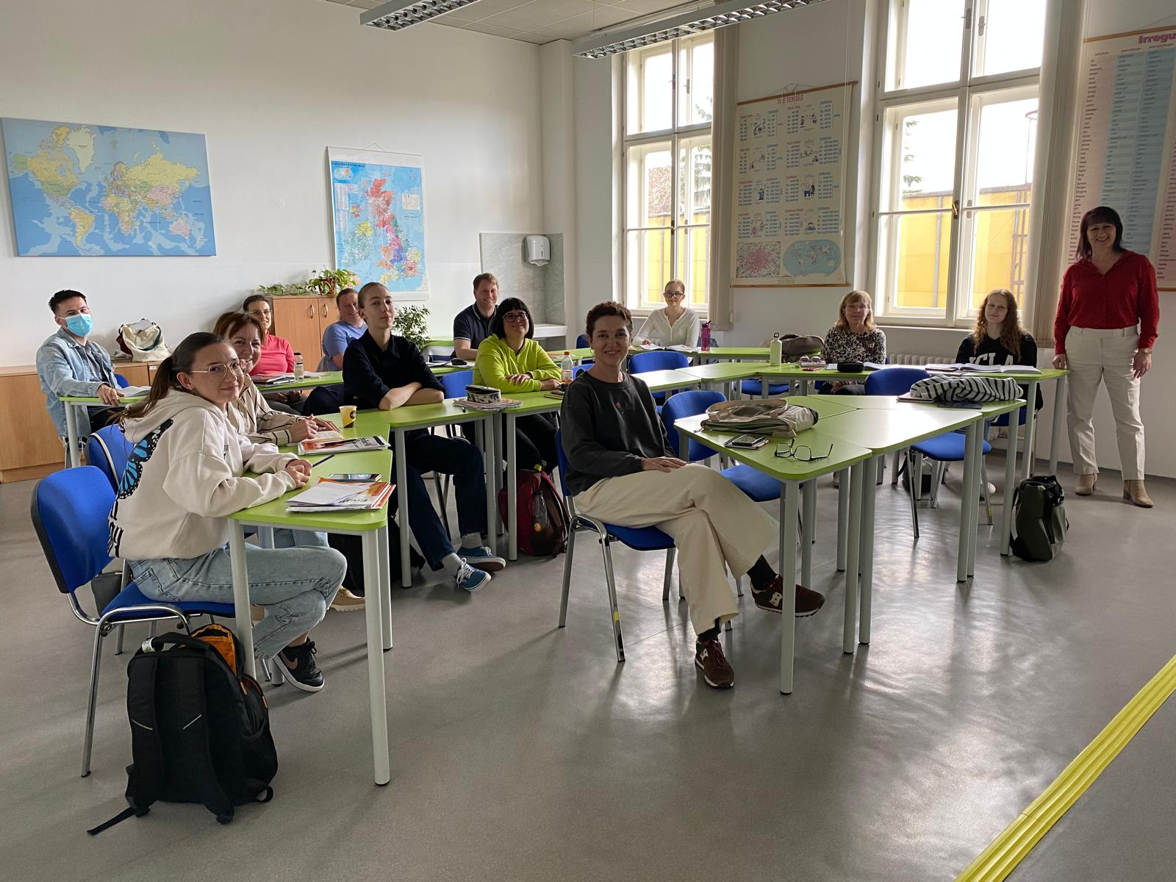
General courses
We observed different types of courses both in the English and in the Spanish department. In those sessions we were able to tell them about Ourense, Galicia and our EOI.

Slide 14
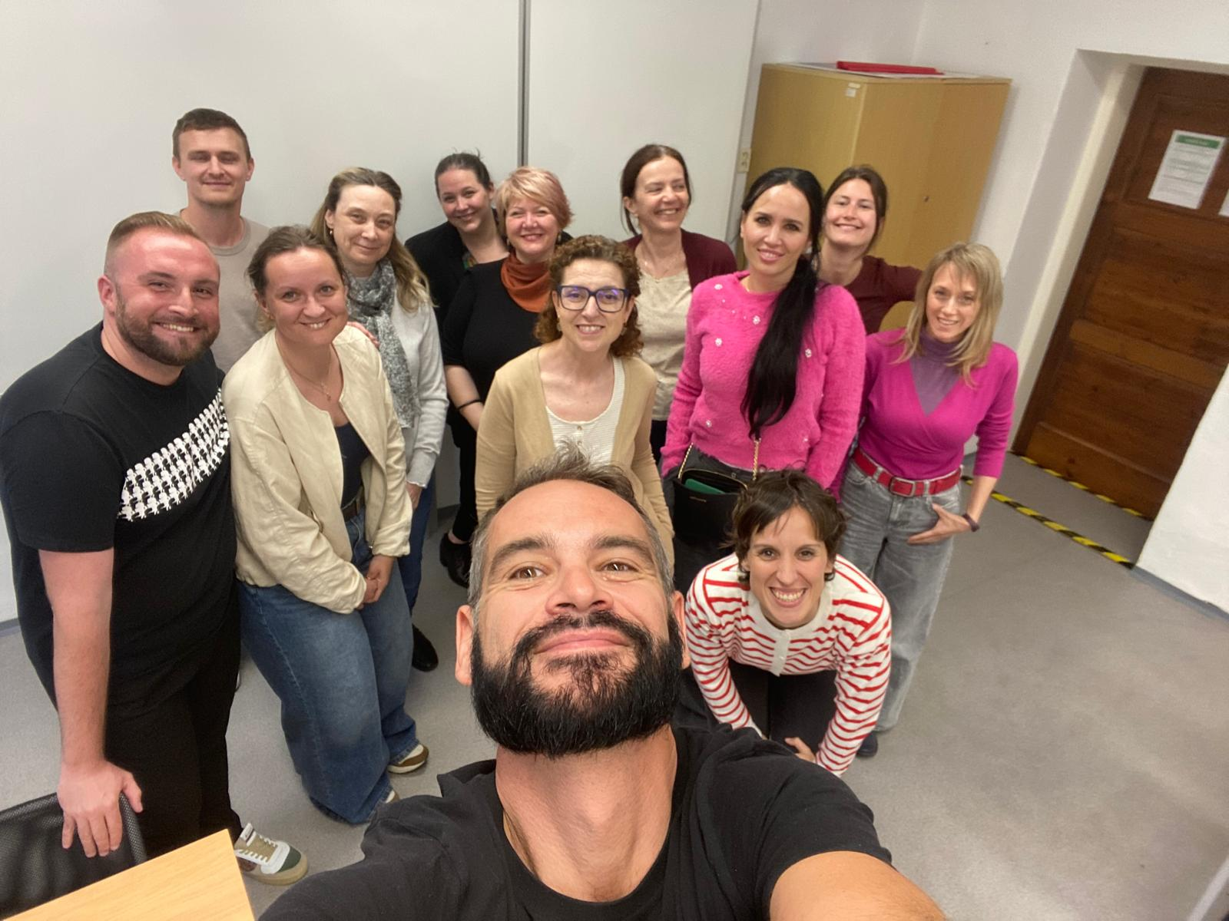
Both teaching staff and student body were very welcoming and shared with us their expertise, their learning/teaching experiences and most importantly their perspective of being Europeans in the context of acquiring foreign languages. We were impressed at the big interest there is in Bratislava about Spain and our languages. In the courses they need to study literature and history because their certification allows them to teach the given language at other schools in the country.
C1 Spanish class

Slide 15
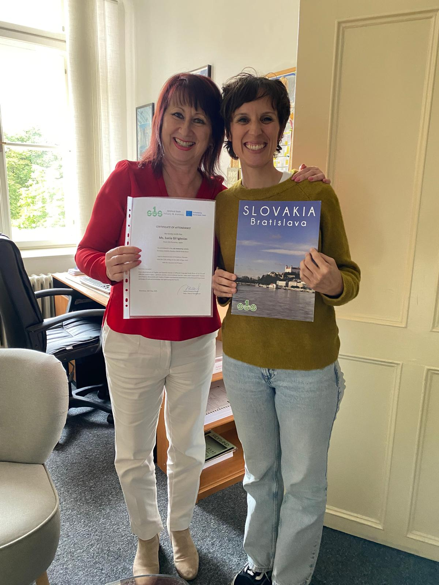
04
The takeaways
Since Jazykova skola is our peer, that is to say, a public run school for adults that teaches languages, we hope that our visit is the beginning of a future connection between our centres. We are really looking forward to future endeavours together such as possible eTwinning projects or the exchange of both teachers and students through the Erasmus+ programme.
We are extremely thankful to all the faculty members of Jazykova skola for their warm welcome, especially to Dr. Eva Zitná (English department), Dr. Peter Gschweng (Spanish department) and Dr. Viktória Gerulová (English and Spanish departments)

Slide 16
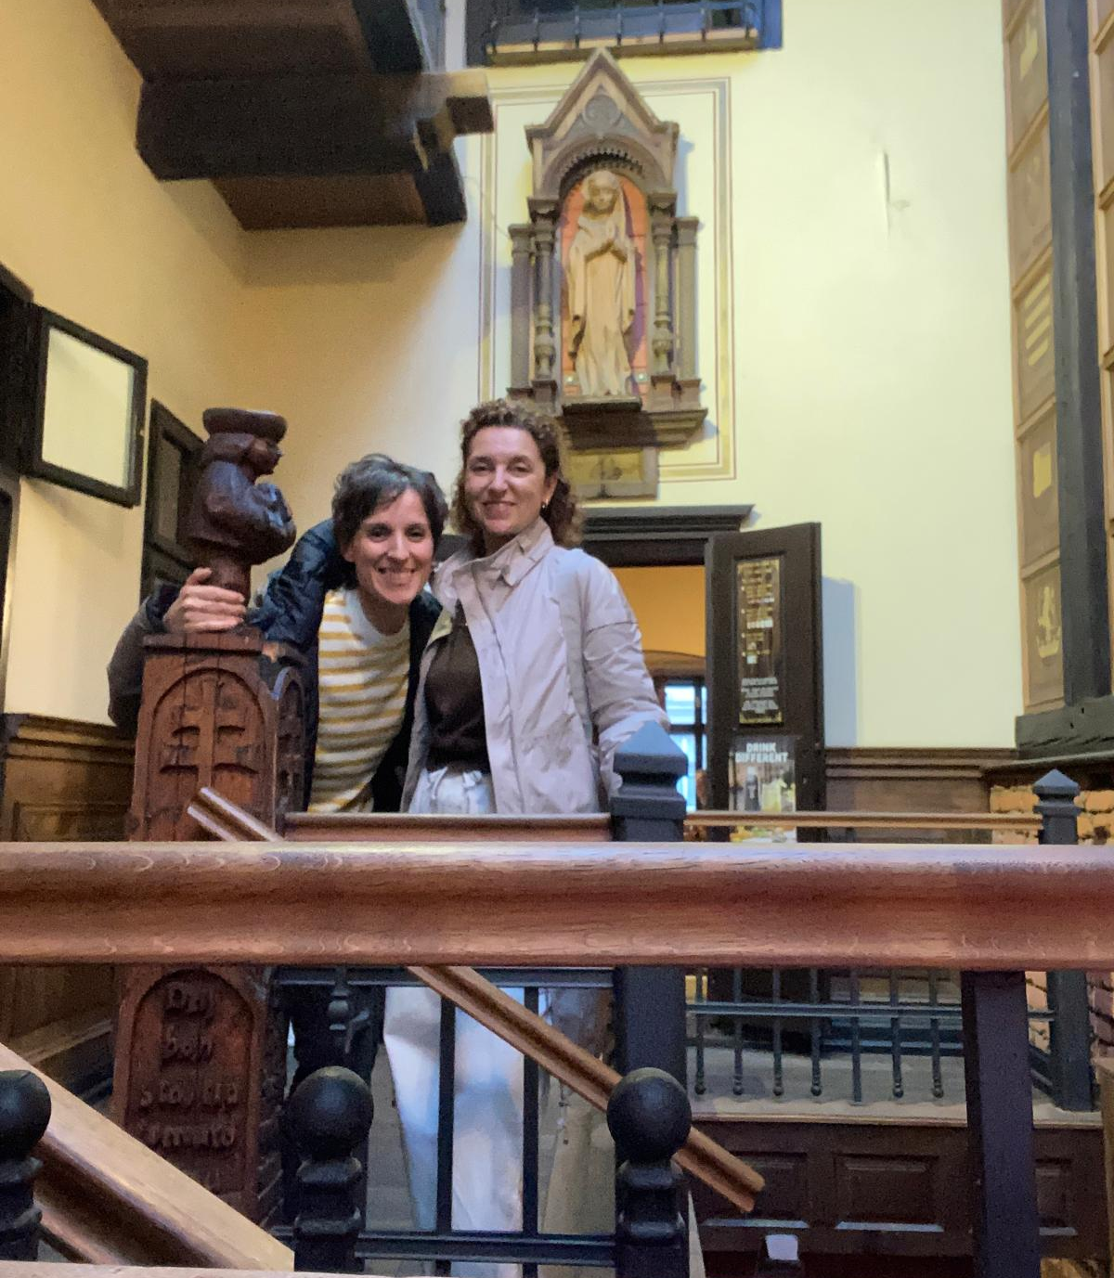
Participants
Lucía Gil Iglesias & Ana Ramos
EOI Ourense
English department
May 2025

Slide 17
Thanks, Erasmus+!

